Slide 1

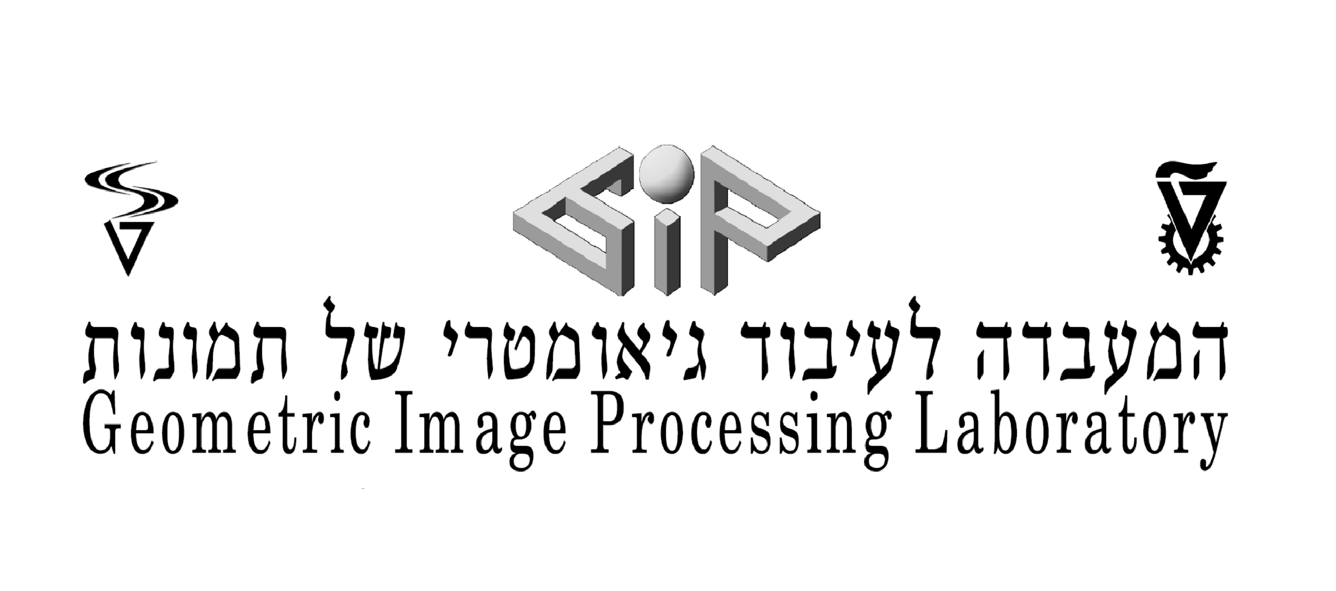

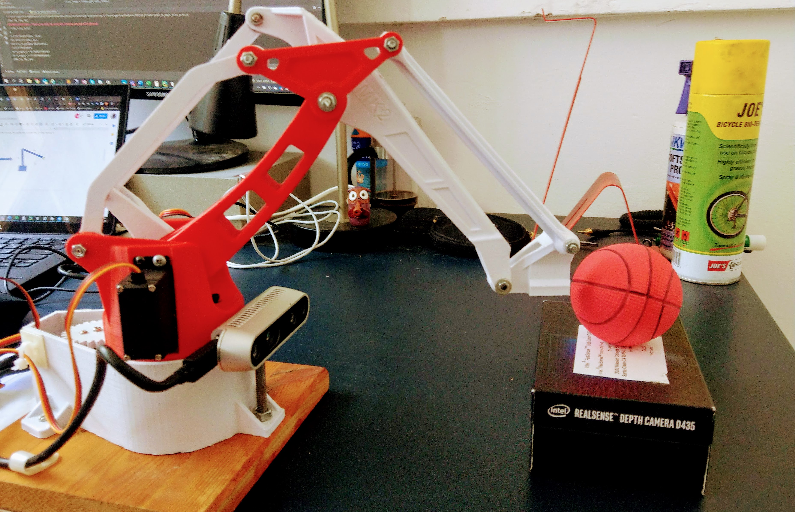
Project Efraim Robotic arm handling fruit using RealSense, Yolact & Arduino
Students : Yonatan Gershon, Annael Abehssera
Supervisors: Yaron Honen, Roman Rabinovich, Andrey Zhitnikov

Slide 2

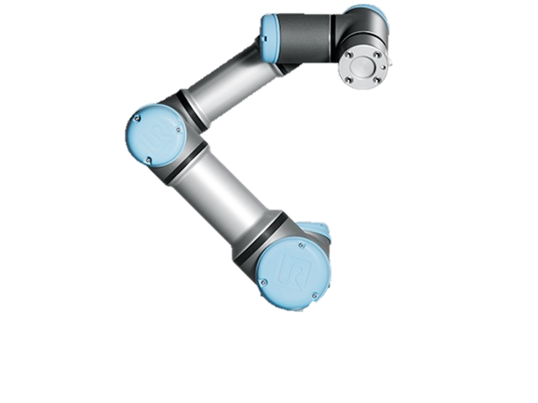
Efraim, the agricultor.

Slide 3
Project plan
Goal : Build a system that can locate a fruit in 3D using an Intel RealSense D435 and handle it with the help of a robotic arm.
Steps :
Image processing
Articles about the domain
Defining image processing model
Test the accuracy of the image processing model
2) Guide the robotic arm to the fruit using the coordinates extracted from the Intel RealSense camera
Locate the fruit with the camera
Simulation of the robotic arm
3) RealSense coordinates to Robotic arm movement
Convert color pixel to coordinates
Calculate arm angles with coordinates
4) Robotic arm calibration to the RealSense Camera
Calibrate arm to servos angles
Configurate Limitations

Slide 4
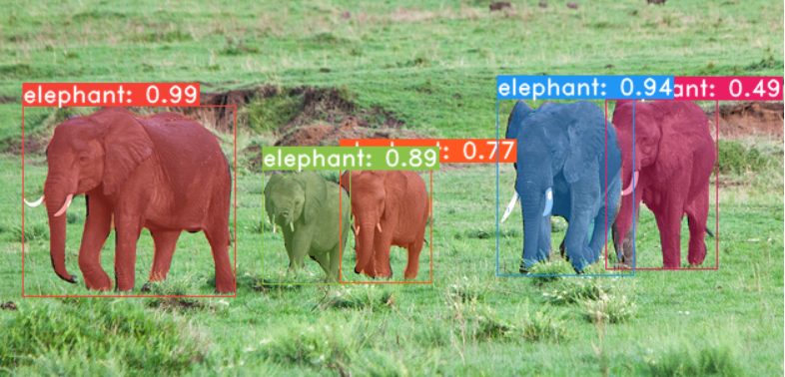
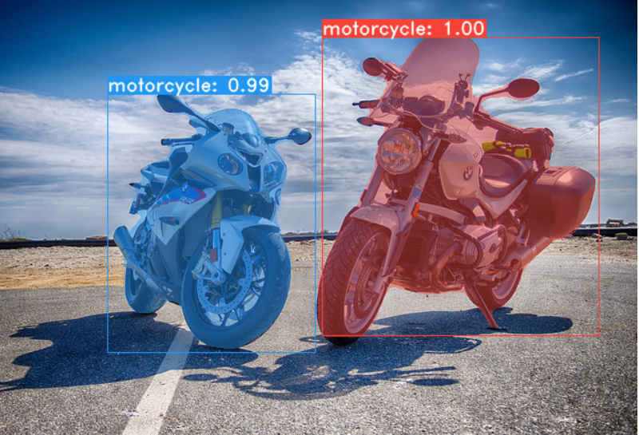
1) Image processing a) Articles about the domain
We read articles regarding YOLO and Yolact.
Understood generally how deep learning works and how a model is trained.
Decided to use COCO model for our image processing
Goal: recognize fruit with YOLO image segmentation
Conclusion : integrate Yolact model & COCO trained model with the RealSense camera in order to locate the fruit in 3D coordinates

Slide 5
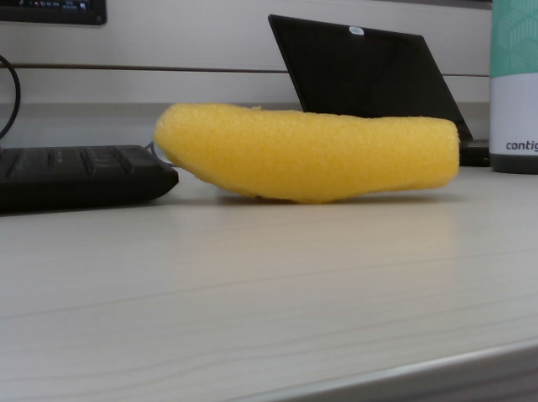
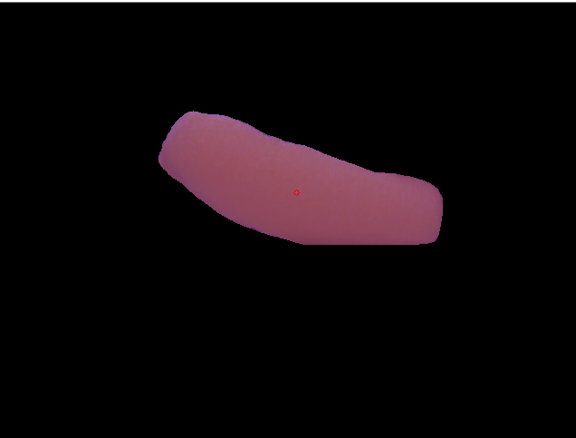
1) Image processing b) Defining image processing model
Used Yolact to segment specific items (bananas in our case)
Integrated Yolact github code with the RealSense camera to receive 3D coordinates for segmented image
Isolate the fruit from its surroundings.
Calculate the best location to grip the fruit.
→

Slide 6
1) Image processing c) Test the accuracy of the image processing model
Main challenge found using Yolact & RealSense
Segmentation wasn’t accurate or stable. The segmentation would sometimes focus on the fruit and abruptly include the surroundings of the fruit. This would cause the COM (center of mass) to be extremely unstable and in practice wasn’t able to locate the fruit with certainty.
Measuring the distance from the fruit and comparing with Efraim’s distance numbers we found large inaccuracies which we believed were caused by the segmentation crudeness.
Conclusion : A solution must be found to locate the fruit with high certainty and decide when the location calculated is valid.

Slide 7
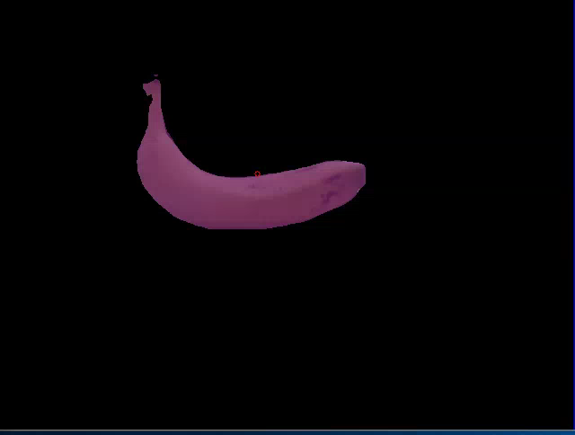
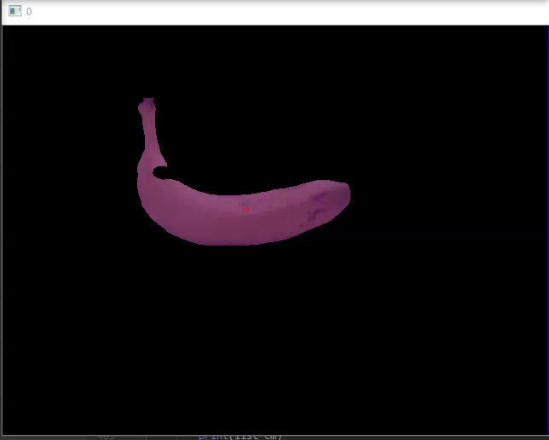
2) Robotic arm movement a) Locate the fruit with the camera
Improving segmentation:
We used heuristics to remove from the segmentation any pixels that were 20cm further than the closest point of the banana.
After the heuristics the COM became more stable but wasn’t yet accurate enough. We viewed the mask matrix and noticed that many pixels would receive a ‘0’ in the depth dimension due to synchronization between the RGB camera and the ‘cloud points’. Removing all the pixels with no depth dimension resulted with an accurate distance & stable COM.
Conclusion : Additional heuristics is needed in order to determine the fruit COM coordinates.

Slide 8
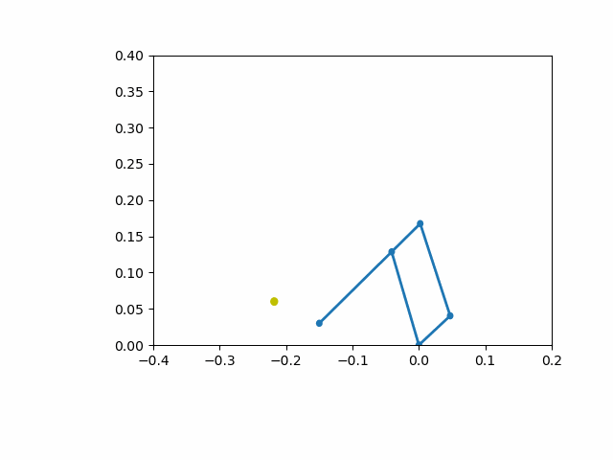
2) Robotic arm movement b) Simulation of the robotic arm
Robotic arm autonomous movement:
The robot decides he knows the correct COM of the banana if he counts 5 consecutive frames with the COM within the margin of 2cm.
Robotic arm movement is calculated using inverse kinematics from the default arm location to the COM of the banana.

Slide 9
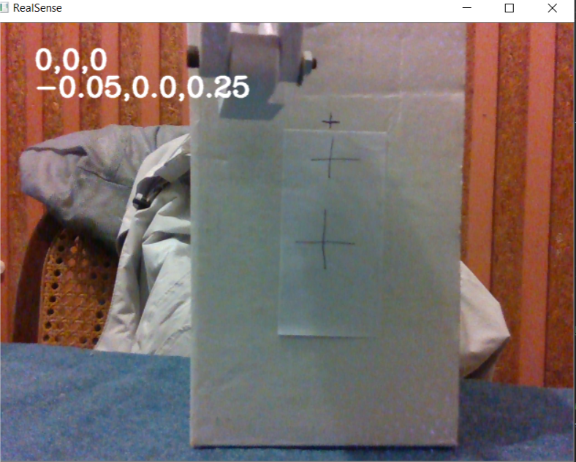
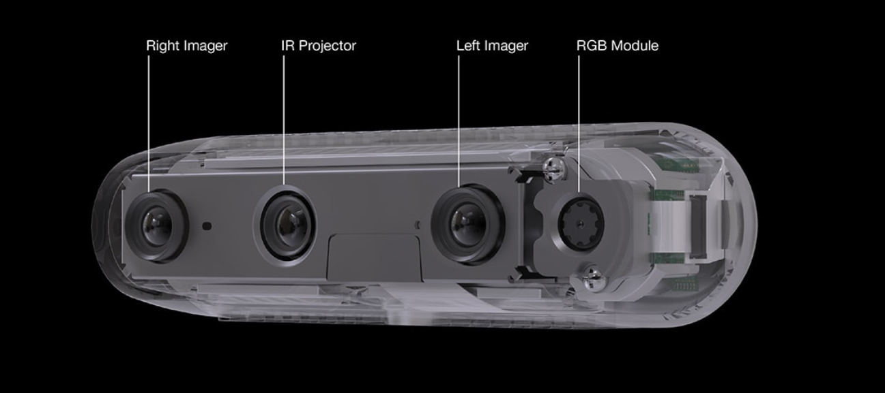
3) RealSense coordinates to Robotic arm movement
a) Convert color pixel to coordinates
Goal: simulate the fruit COM by clicking with the cursor on a pixel
of the RealSense RGB camera and retrieving the 3D coordinates .
Mouse pointer selects pixel in color frame. The reason we pick the pixel from the color frame is because the Image Processing is done on this frame.
Convert pixel from color frame to depth frame using RealSense library function: rs2_project_color_pixel_to_depth_pixel
Convert depth pixel to real life coordinates using RealSense library function: rs2_deproject_pixel_to_point

Slide 10
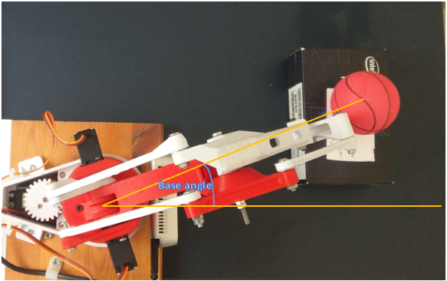
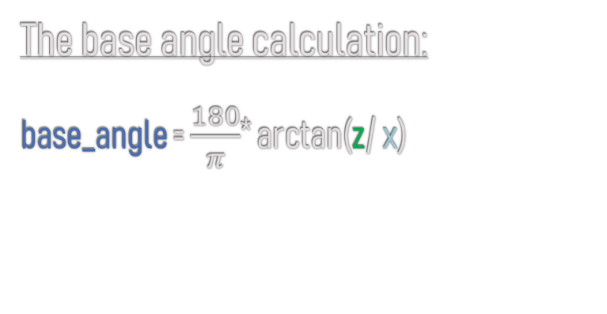
3) RealSense coordinates to Robotic arm movement
b) Calculate arm angles with coordinates
The base angle calculation:
base_angle = $\frac{180}{π}$* arctan(z/ x)
X
Z

Slide 11
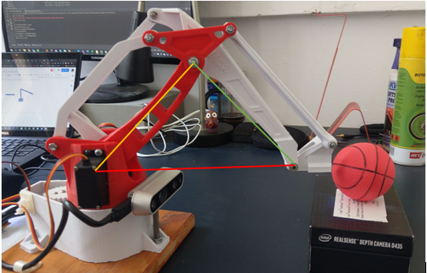
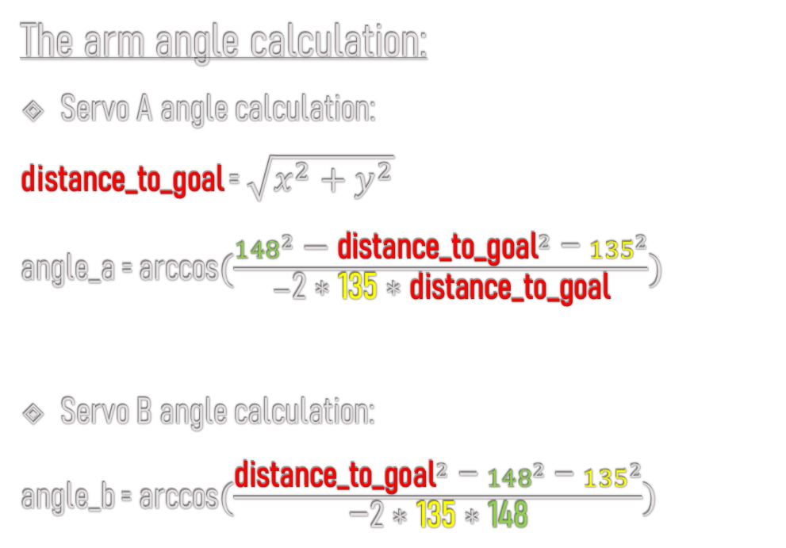
3) RealSense coordinates to Robotic arm movement
b) Calculate arm angles with coordinates
The arm angle calculation:
Servo A angle calculation:
distance_to_goal = $\sqrt{x^{2}+y^{2}}$
angle_a = arccos$(\frac{{{148}^{2}\text{ − }\text{distance}\text{_}\text{to}\text{_}\text{goal}}^{2} \text{− }{135}^{2}}{−\text{2 ∗ }\text{135}\text{ ∗ }\text{distance}\text{_}\text{to}\text{_}\text{goal}})$
Servo B angle calculation:
angle_b = arccos$(\frac{{\text{distance}\text{_}\text{to}\text{_}\text{goal}}^{2} \text{− }{148}^{2} \text{− }{135}^{2}}{\text{−2 ∗ }\text{135}\text{ ∗ }\text{148}})$
4cm
Removing 4cm from z since gripper is always parallel to x,z plane

Slide 12
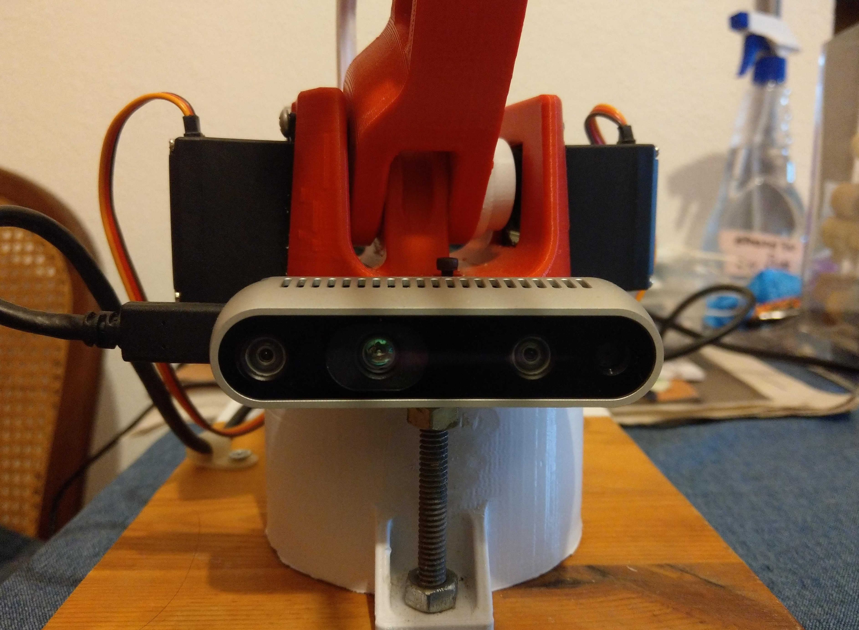
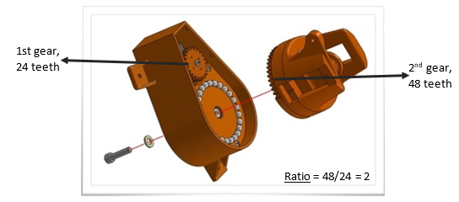
4) Robotic arm calibration to the RealSense Camera
a) Calibrate arm to servos angles
The base angle calibration:
Adjust the (0,0,0) coordinates from the RealSense camera to the robotic arm base: x -= 0.02, y += 0.04 , z += 0.06
Calculate the Base angle rotation using the ratio between the number of teeth of the 2 gears in Efraim’s base: Angle factor = 2

Slide 13
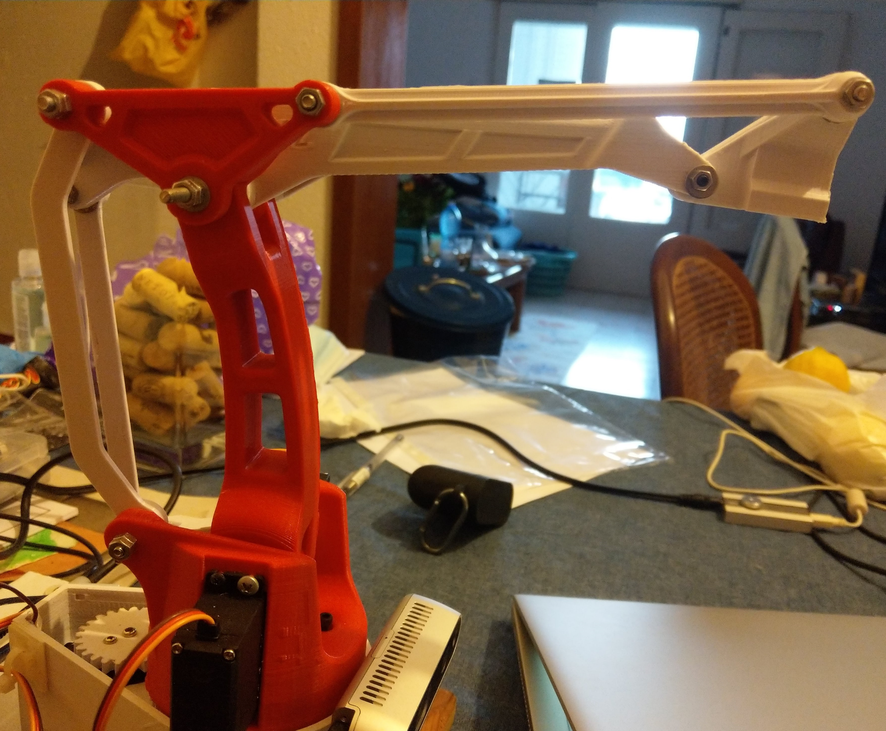
4) Robotic arm calibration to the RealSense Camera
a) Calibrate arm to servos angles
The servo angle calibration was done at all 90 degrees

Slide 14
4) Robotic arm calibration to the RealSense Camera
b) Limitations
Arm movement limitation
base angle = 25 – 165 | red arm = 55 – 140 | white arm = 55 - 145
RealSense camera limitation
The RealSense camera can only calculate the depth of objects from 15cm away and the arm can only reach as far as 19 cm ➔ Efraim has only 4 cm of operational area

Slide 15
Efraim1 Overview
RealSense RGB Image
Yolact
RealSense world coordinates + heuristics
Robotic arm angles calculation
Servo calibration
Arduino communication

Slide 16
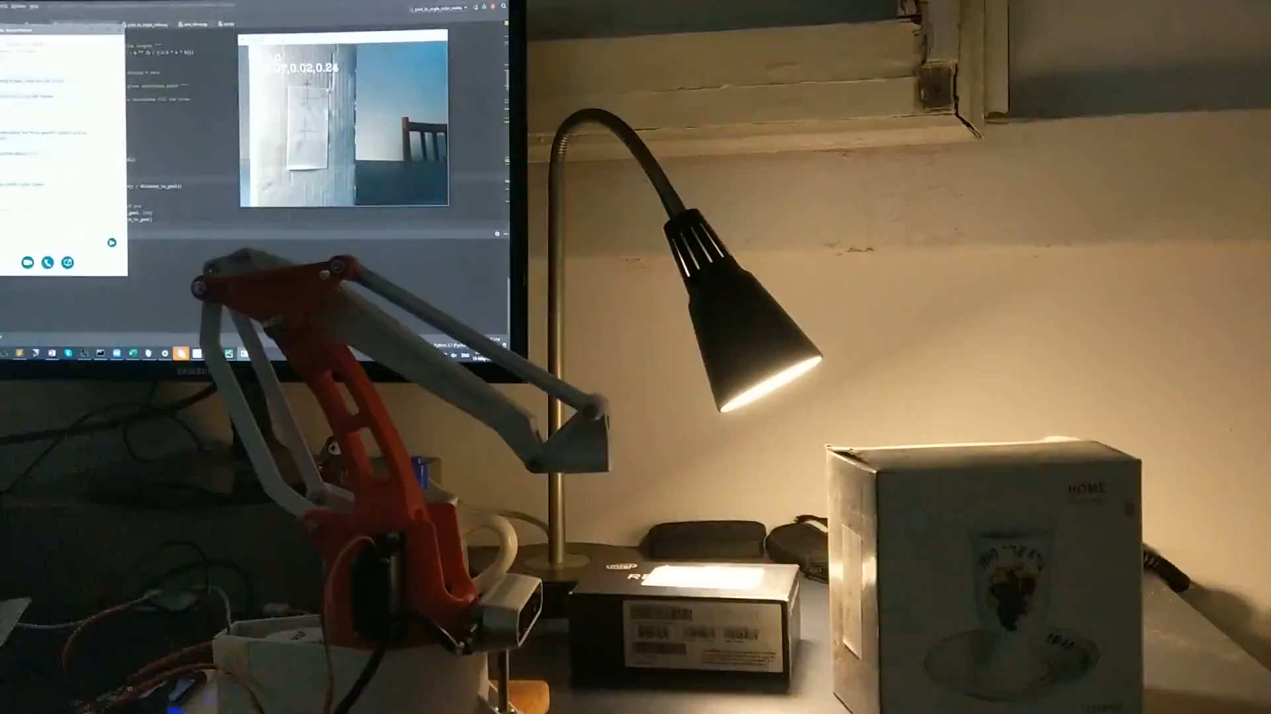

Slide 17
References
https://towardsdatascience.com/yolo-you-only-look-once-real-time-object-detection-explained-492dc9230006
https://medium.com/@jonathan_hui/real-time-object-detection-with-yolo-yolov2-28b1b93e2088
https://github.com/dbolya/yolact
https://github.com/IntelRealSense/librealsense/wiki/Projection-in-RealSense-SDK-2.0#point-cloud

